Slide 1
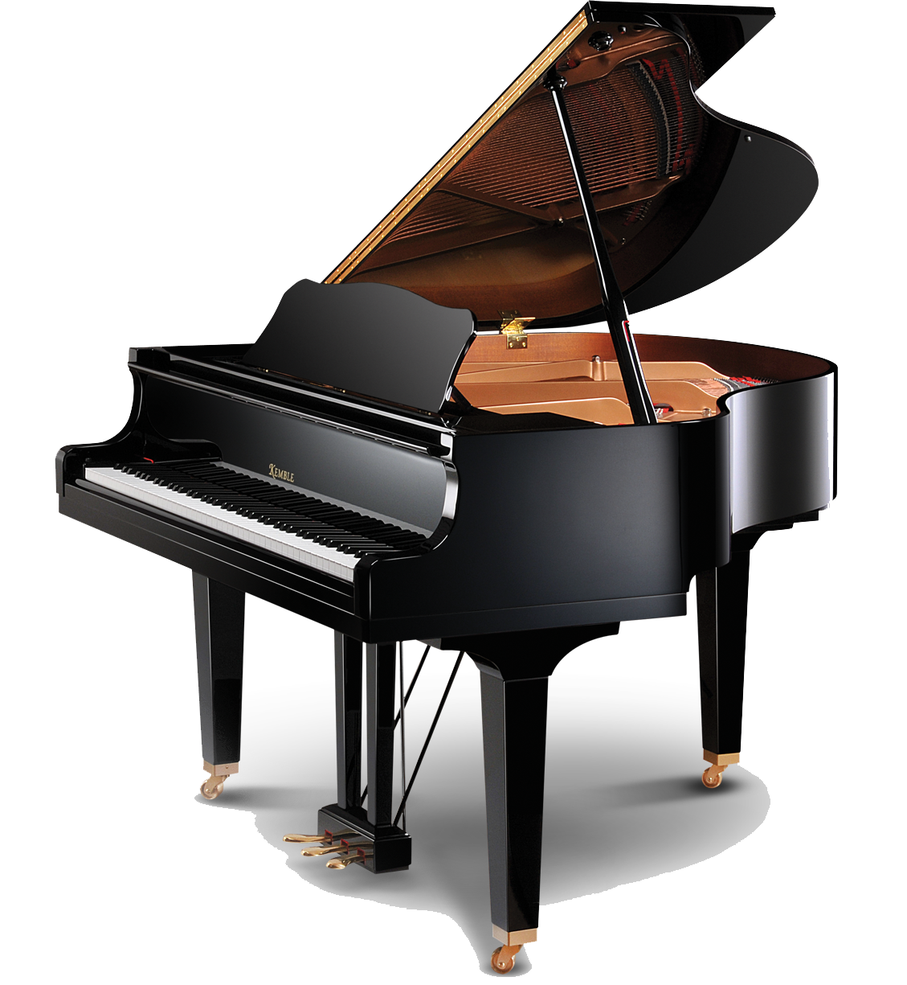
B1
ALTAR
C1
B5
C5
5:30 p.m.
MASS
B2
C2
C3b
C3a
Father
B3
B4
C4a
C4b
Baptismal
Font
B1
ALTAR
C1
8:30 a.m. &
11:30 a.m.
MASSES
B2
C2
Father
B5
C5
C3
B3
B4
C4
Baptismal
Font
B1
ALTAR
C1
10:00 a.m.
MASS
C6
B6
B5
C5
B2
C2
C3b
C3a
Father
B3
B4
C4a
C4b
Baptismal
Font

